Slide 1
PIBAS General Ledger – 12-May-2014
Presented By: PIBAS Support Department

Slide 2
Contents
General Ledger
Structure of Account
Level of Accounts and PIBAS Allocated Series for Chart of Accounts
General Ledger Account Maintenance
- Account Opening
- Account Maintenance
- Account Supervision
General Ledger Voucher Maintenance
- Voucher Entry
- Voucher Supervision / Cancellation
General Ledger Inquiries
- Drill Down Facility for Vouchers and Accounts
- Account Inquiry
- Voucher Transaction Review
General Ledger Parameters
- Cost Center Code Maintenance
- Employee Maintenance
- Budget Maintenance
- Parameter Account Maintenance
General Ledger Reports
- Trial Balance Report
- Statement Report
- Statement of Affair Report
- Profit and Loss Report
- Account list (Chart of Accounts Report)
- Voucher Transaction List
- Budgeting – Expense Head Wise….
- Budgeting – Cost Center Budget Month Wise….
- Expense / Income – Cost Center….
- Parameter Accounts Statement
- Voucher Printing / Reprinting
- Day Book Report
- Parameters Report

Slide 3
Contents
General Ledger
Account => General Ledger Account Change
- General Ledger Account Maintenance
- General Ledger Account Supervision
- General Ledger Account Maintenance Report
Maintenance => Parameter 1 => Account Type Maintenance
Maintenance => Parameter 1 => System Default Accounts Maintenance
Maintenance => Parameter 1 => Statement of Affairs Maintenance
List of Important Reports for Finance / Accounts Division
Hands On Training AND Day-to-Day Issues & Their Remedies

Slide 4
Structure of Account
General Ledger
Structure of Account is same for Customer and Internal / General Ledger Accounts
Account number of PIBAS System has mainly three parts i.e. 1. Prefix, 2. Basic and 3. Suffix
Prefix is 4 digit number that represents Branch Code / Unit Code
Basic is 7 digit number that usually remains same for one Customer / GL and in case of a new Customer / GL, available random number will be granted to the account that is going to be opened.
Suffix is 4 digit number that represents account type.
Example: PPPP-BBBBBBB-SSSS
Where
PPPP represents Branch Code / Unit Code
BBBBBBB represents Customer / GL Basic Number
SSSS represents Account Type

Slide 5
Level of Accounts and
PIBAS Allocated Series for Chart of Accounts
General Ledger
9 01 02 03 and 8 Series
9 - First Level
01 - Second Level
02 - Third Level
03 - Fourth Level
8 Series - Fifth Level
9010000 - 9309999 Liabilities
9310000 - 9359999 Sundry Creditors
9360000 - 9399999 Income
9400000 - 9709999 Assets
9710000 - 9749999 Sundry Debtor
9760000 - 9799999 Expense
9810000 - 9819999 Below the line / Contingent Liabilities
9820000 - 9829999 Below the line / Contingent Assets

Slide 6
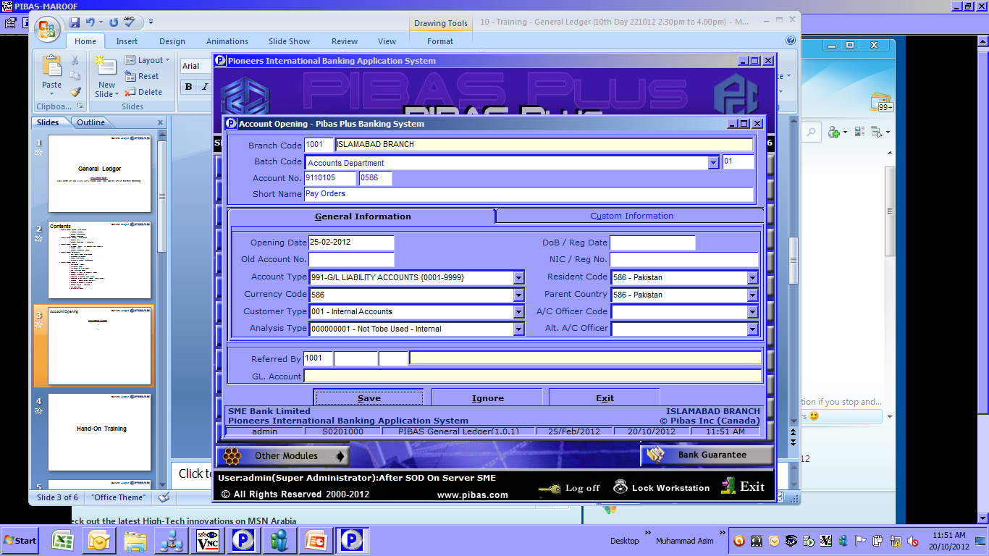
Account Opening
General Ledger
Through this option only GL Accounts can be opened. GL Accounts are internal accounts whose Basic Numbers are greater than 7777777

Slide 7
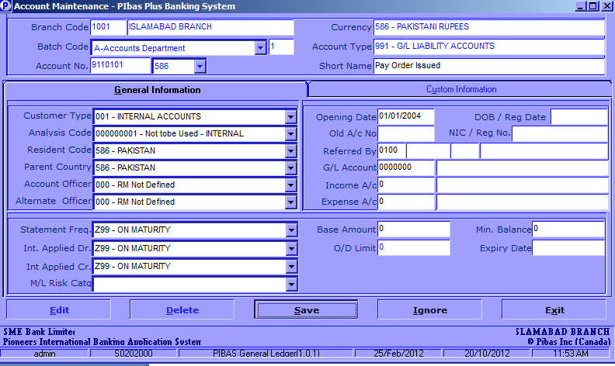
Account Maintenance
General Ledger
Through this option any GL Account can be amended with respect to different properties except Account Type.
Here Income and Expenses accounts can also be defined for a GL. For Example for a Loan Product GL, an markup income account will be defined and for a Deposit Product GL, an profit expense will be defined.

Slide 8
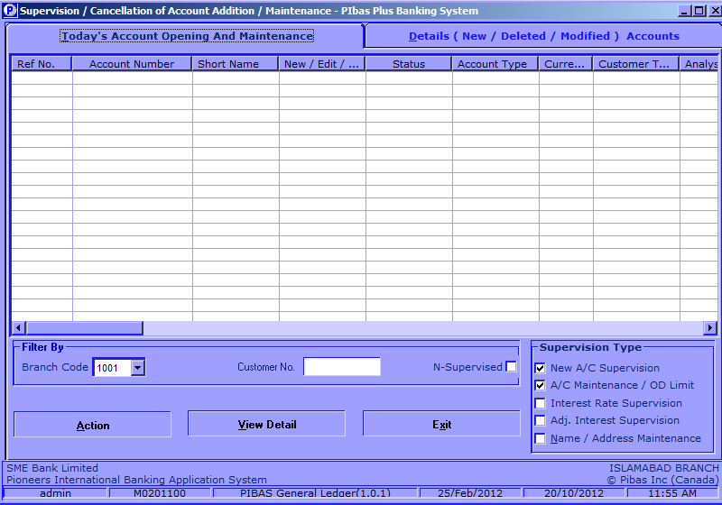
Account Supervision
General Ledger
Through this option any newly opened GL or amended GL Account can be Supervised.

Slide 9
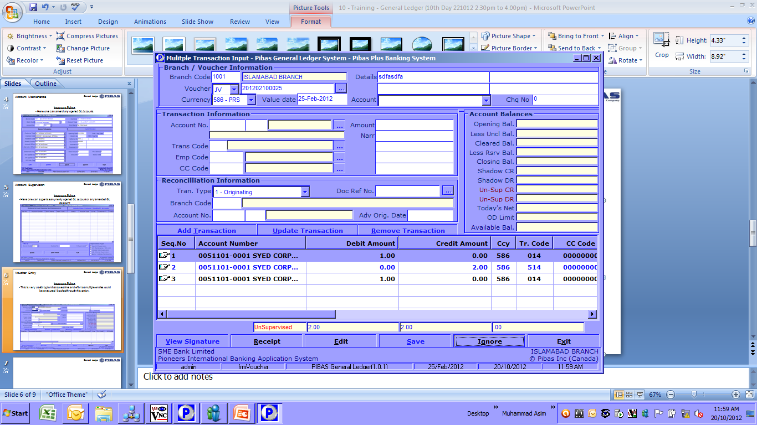
Voucher Entry
General Ledger
This is very useful option that saves time and effort as multiple entries could be executed / booked through this option.
Here both GL and Customer Account transactions could be done but preferably it should be used for GL related transactions.
While posting of multiple entries you can also note the following difference amount that will appear till the end of balancing of debit and credit
Through this option other vouchers of previous days, can also be viewed.

Slide 10
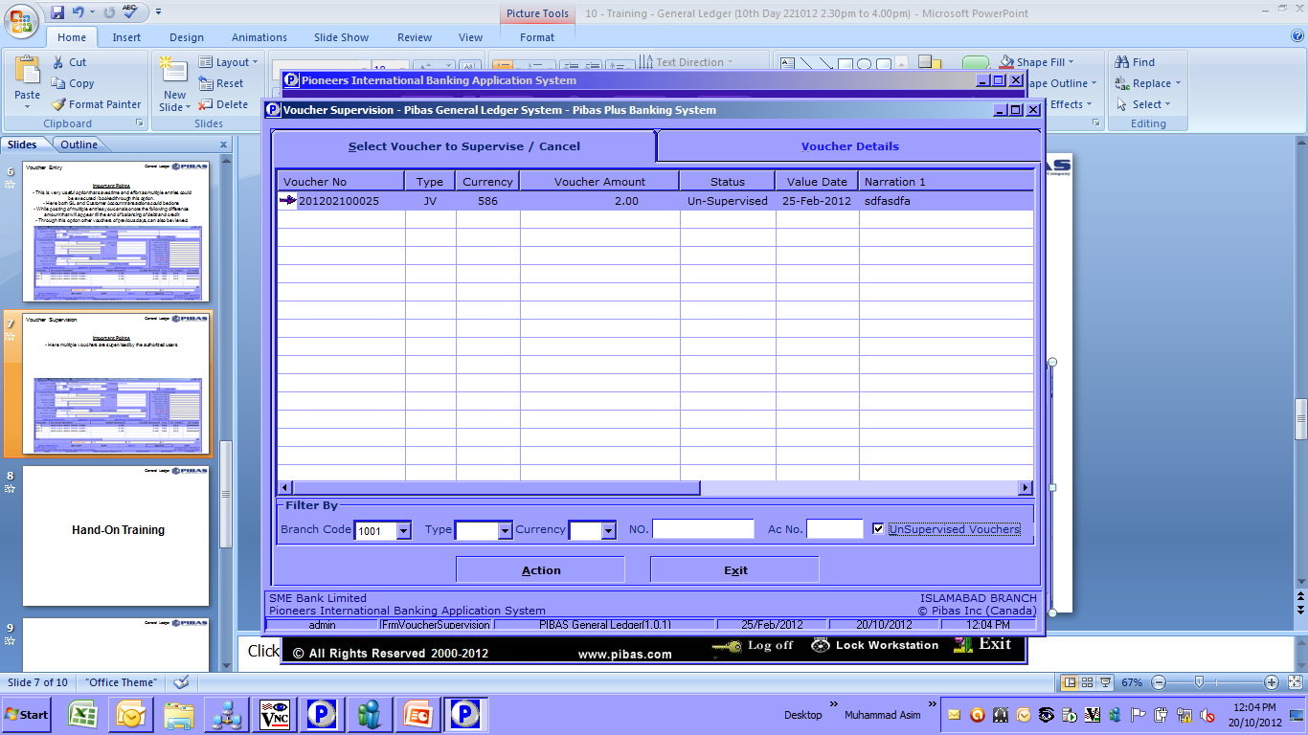
Voucher Supervision
General Ledger
Here multiple vouchers are supervised by the authorized users

Slide 11
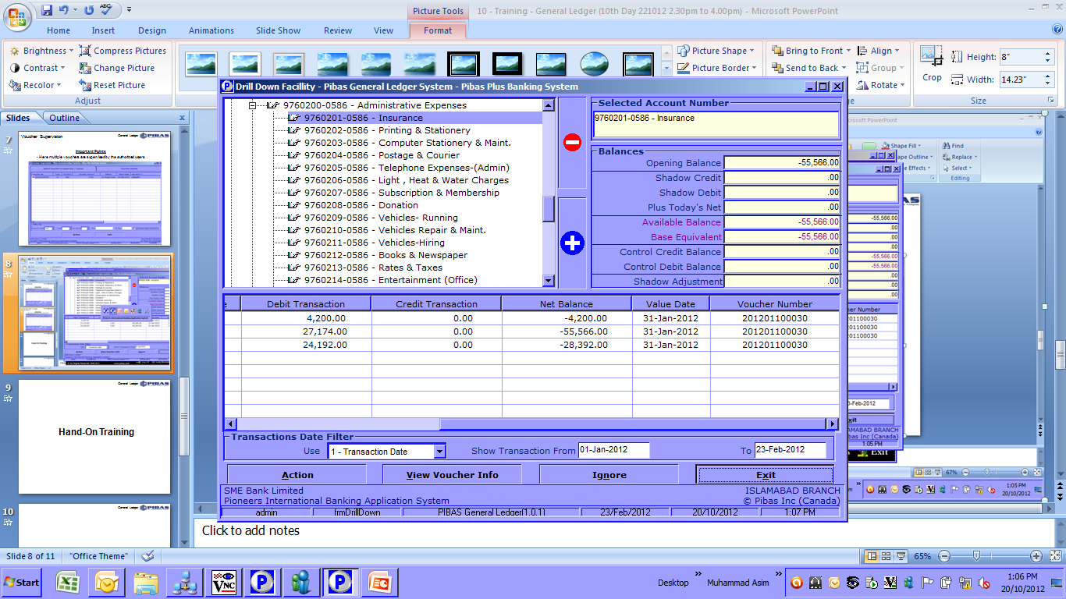
Drill Down Facility for Vouchers and Accounts
General Ledger
This facility provides detailed history of voucher, account wise / voucher wise
Here previous vouchers can also be printed
This option saves time and effort regarding retrieval of voucher on system instead of search for physical vouchers

Slide 12
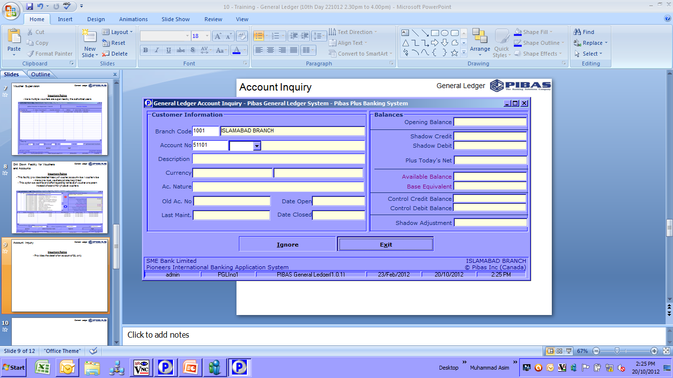
Account Inquiry
General Ledger
Provides the detail of an account of GL only

Slide 13
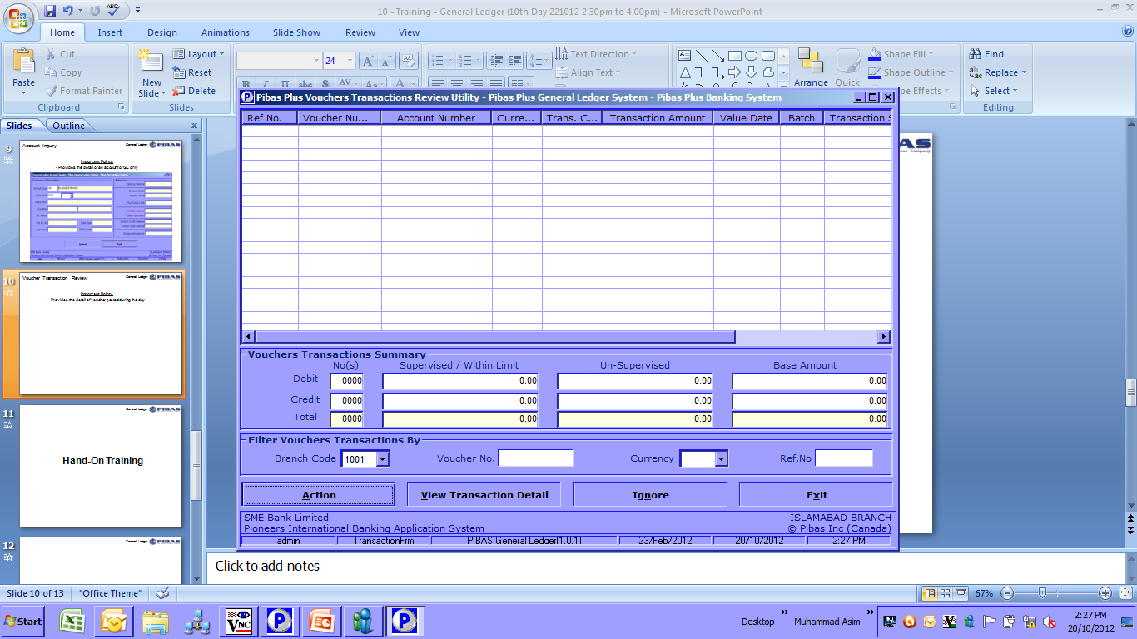
Voucher Transaction Review
General Ledger
Provides the detail of voucher posted during the day

Slide 14
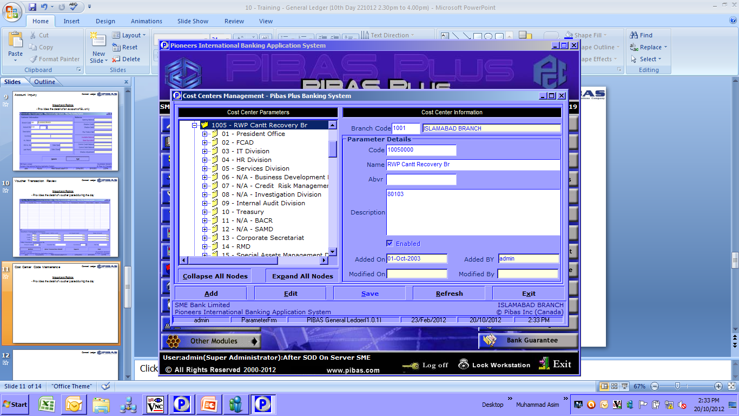
Cost Center Code Maintenance
General Ledger
Here Cost Center Parameter are added and changed

Slide 15
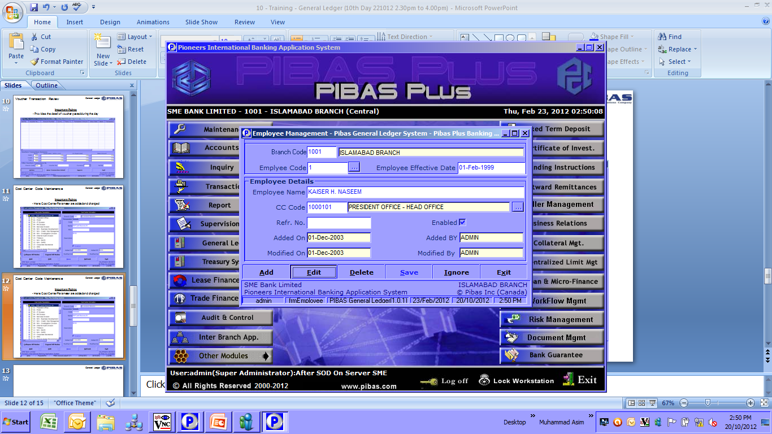
Employee Maintenance
General Ledger
Here Employee Parameters are added and changed along with tagging / linking with respective cost center / branch

Slide 16
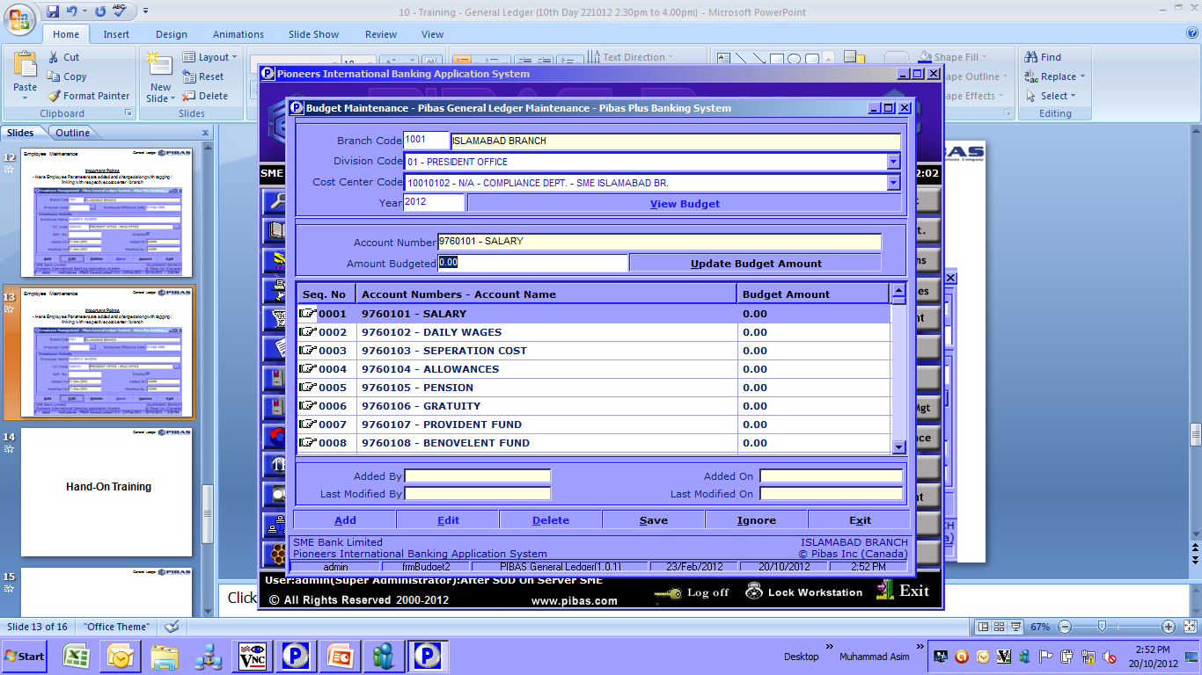
Budget Maintenance
General Ledger
Here Budget Amounts are added / changed to analyze budget related reports

Slide 17
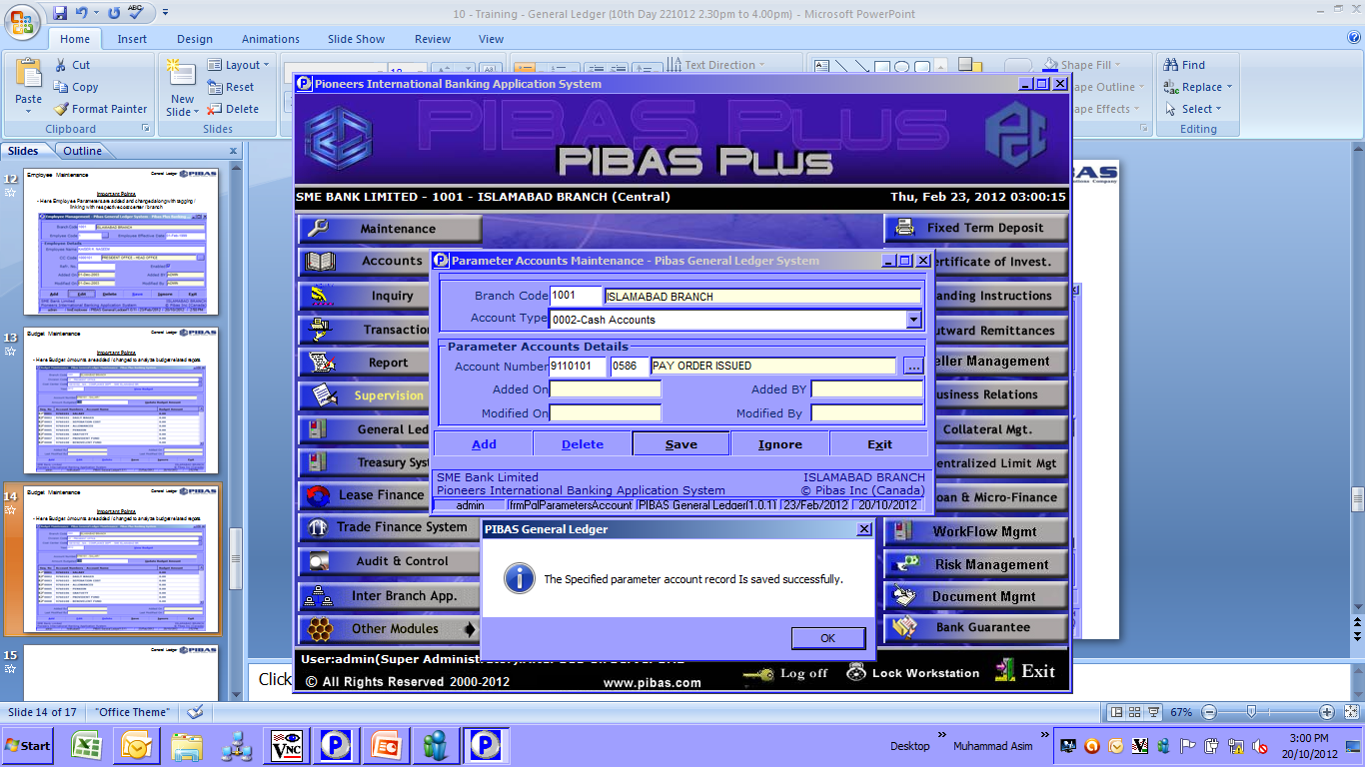
Parameter Account Maintenance
General Ledger
Here Account Number Parameters are added / changed

Slide 18
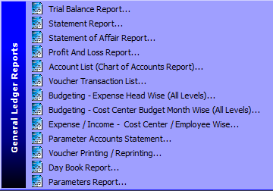
General Ledger Reports
General Ledger
Here following important reports are available that we will analyze by generating one by one

Slide 19
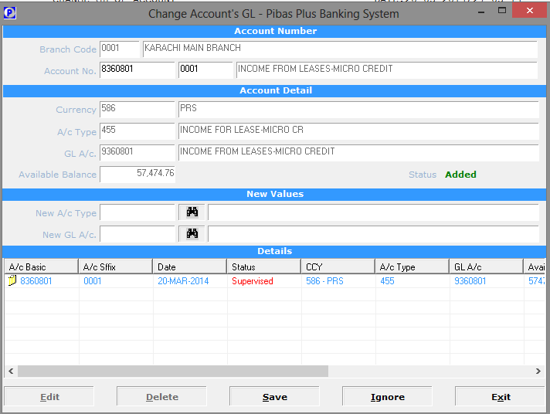
General Ledger Account Maintenance
General Ledger
Through this option GL and Account Type of any GL can be changed

Slide 20
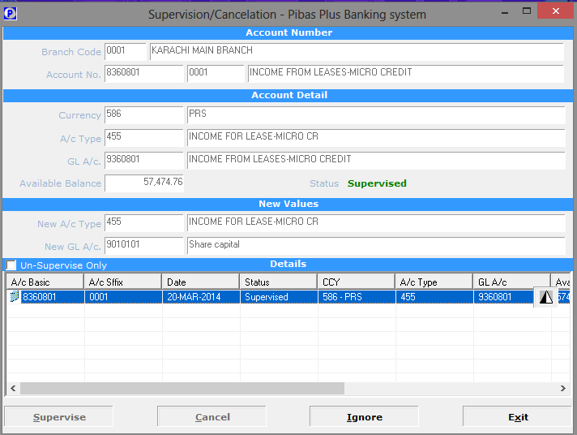
General Ledger Accounts Supervision
General Ledger
Through this option any maintenance can be supervised

Slide 21
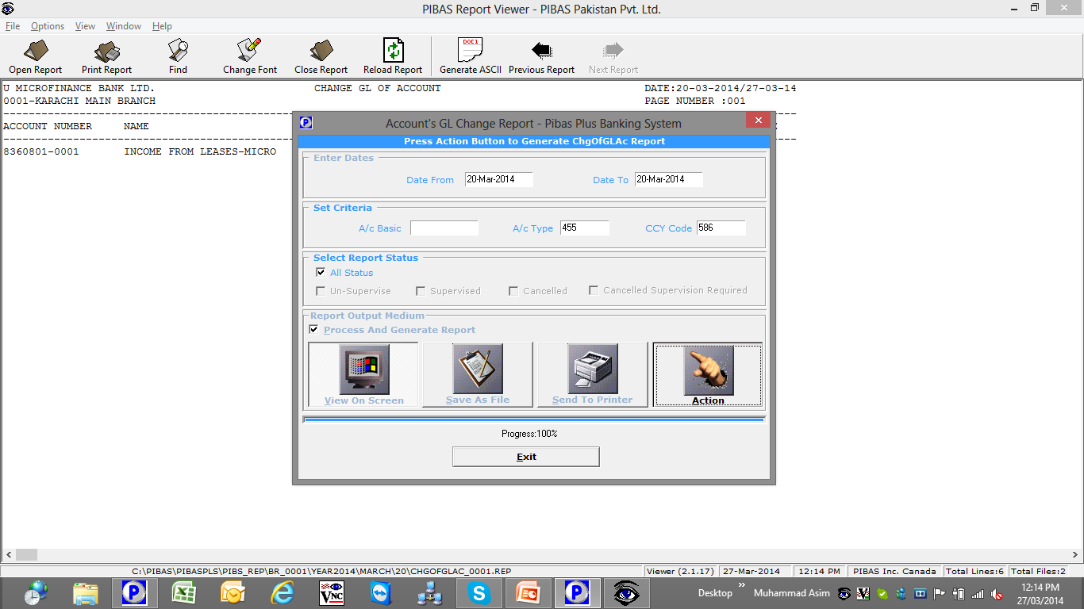
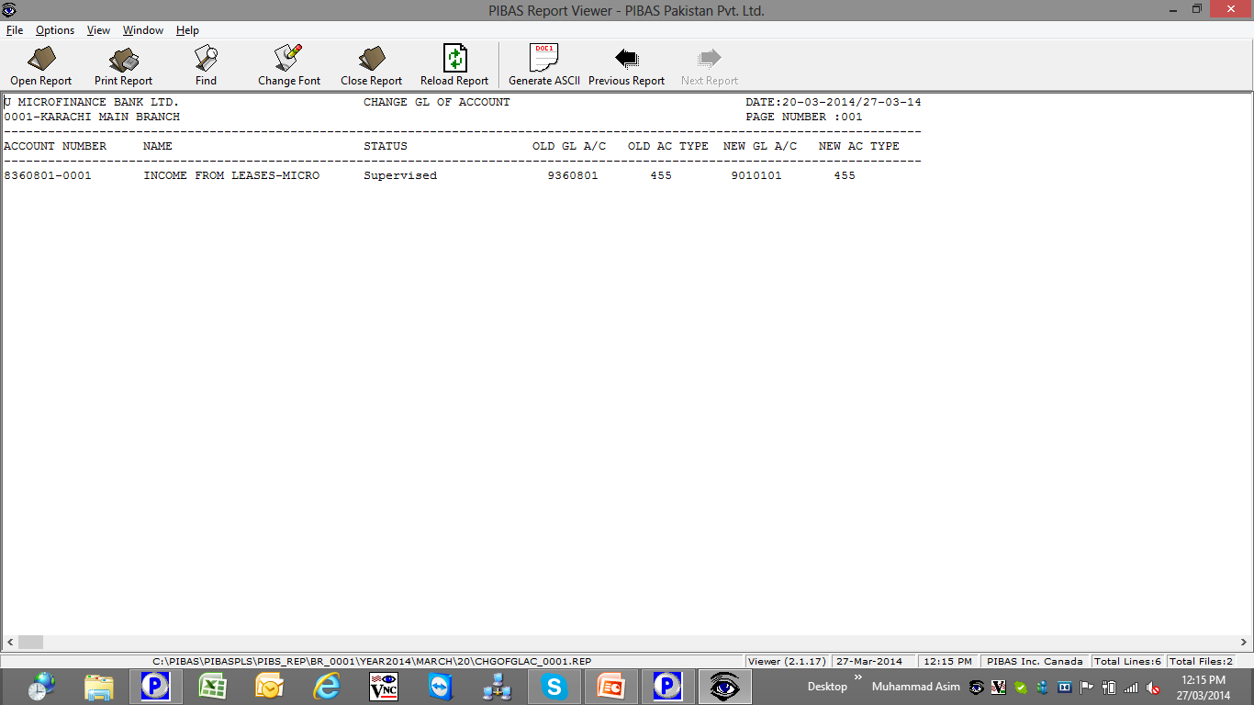
General Ledger Account Maintenance Report
General Ledger
This reports represents maintenance of accounts

Slide 22
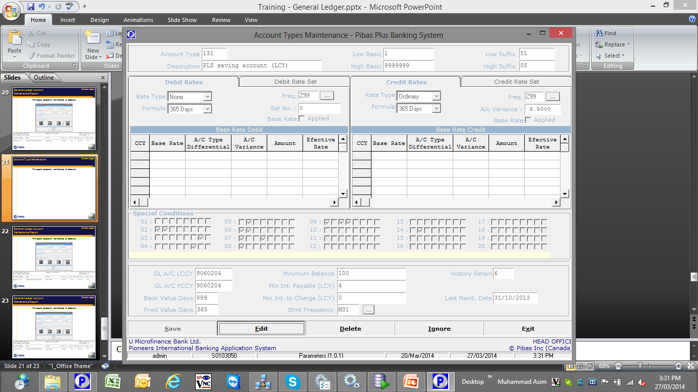
Account Type Maintenance
General Ledger
This option is used to define any Product and its features
All changes made in this menu will be applicable for ‘to be opened accounts’ and not only for existing accounts
GL Definition in this screen is also important wherein accounts of this products will be opened under this GL

Slide 23
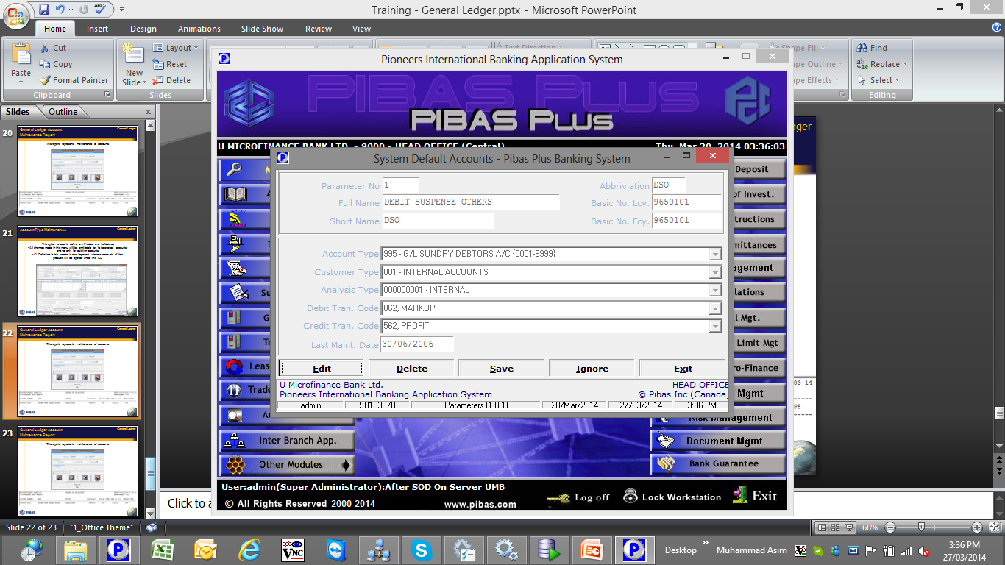
System Default Accounts Maintenance
General Ledger
This option is used to define System Default Accounts that are used for System Generated Entries during End of Day Process

Slide 24
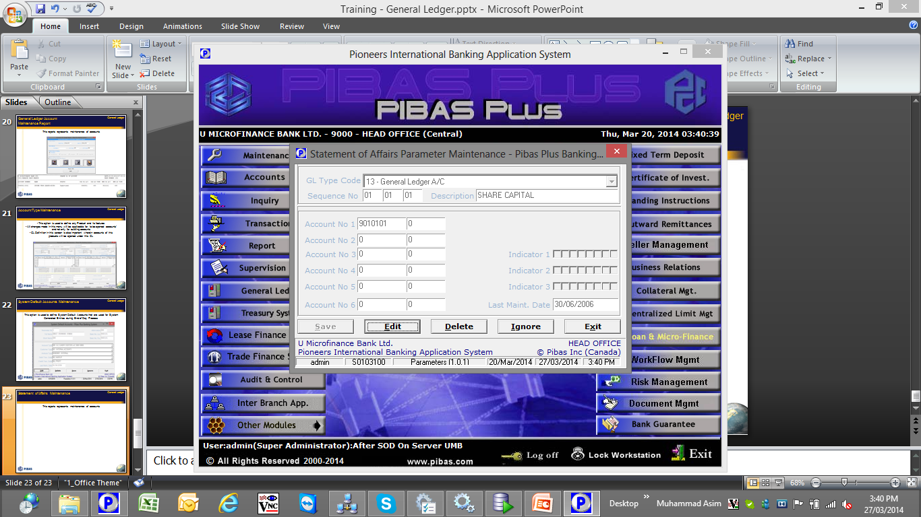
Statement of Affairs Maintenance
General Ledger
This option is used for the definition of accounts in Statement of Affairs, it includes Grouping, Sub-Totaling and Grand-Totaling etc.

Slide 25
List of Important Reports for Finance / Accounts Division
General Ledger
All reports from System must be reviewed by all concerned persons / units, however following are some important reports that should be monitored by Finance / Accounts Division:
END OF DAY REPORTS
(These reports are automatically generated and saved in respective report folder on daily basis during End of Day / End of Day Reports Process)
GLLIST.REP (Complete information of GLs of all units including Income / Expense / Payable / Receivable Accounts.
GL_Account_Wise_Transaction_List.Rep
M013AFA (Statement of Affairs)
M013AFB (Sundry Debtors / Creditors)
M013AFC (Income and Expenditure)
Pgl_TrialBalance.pcr (Consolidated Trial Balance)
TB_05.Rep (Level 5 Trial Balance of Individual Branches)
M013FH.REP (General Ledger Account Wise List)
M013BYA (Comparative Statement of Affairs)
M013BYB (Comparative Sundry Debtors / Creditors)
M012BE.REP (Accrued Mup/Pft Posting)
M013BYC (Comparative Income and Expenditure)
ChgOfGLAc_0001.rep and etc……
ON DEMAND REPORTS
(These reports can be generated by user whenever required. These are available in Report and General Ledger Menu)
Parameter List
Turnover Statics Reports for any GL or Customer
F065 and Consolidated F065 (Account List with so many controls / criterias)
Summary of Transactions
Average of Balances and Consolidated Average Balance Report
Trial Balance / Statement of Affairs / Sundry Debtors / Creditors / Income & Expense (branch wise and consolidated) and etc……….

Slide 26
Hands On Training AND Day-to-Day Issues & Their Remedies
General Ledger
Hands On Training
This practical session will help YOU to get more familiarity on General Ledger Module.
Day-to-Day Issues & Their Remedies
These are the issues that create due to Users Mistakes / Less-Familiarity with the system. System Generated Errors / Issues are not part of it. This session will help YOU to resolve these issues YOURSELVES without the help of Vendors.

Slide 27
General Ledger
Many Thanks
For your precious time for this Presentation Session;
Your queries are always welcomed…….

